Slide 1

Tomato Trail: Rotten Tomatoes Movie Data Analysis
Presented By:
Sai Lakshmi Rajulapati
Batch No: 522

Slide 2

About me
Background: I recently completed my B.Tech in Computer Science Engineering (Data Science) from Sreyas Institute of Engineering and Technology. Throughout my studies, I developed a strong interest in Data Analytics and its applications in data-driven decision-making
Name: SAI LAKSHMI
Roll Number: 81020204926
Batch Number: 522
LinkedIn: https://www.linkedin.com/in/sai-lakshmi-rajulapati/
GitHub: https://github.com/SAI-798

Slide 3
Agenda
Business Problem
Problems Statement
Objective
Dataset Description
Columns Description
EDA Overview
EDA Analysis
Key Insights
Conclusion
Questions & Answers

Slide 4
BUSINESS PROBLEM
High Industry Reliance: Platforms depend on aggregated critic & audience ratings to curate content and predict viewing trends.
Data Accessibility Bottleneck: Raw ratings and metadata are locked behind web structures, preventing real-time, automated analysis.
Missed Opportunity: Without clean, automated data feeds, media companies lose valuable market intelligence on audience preferences.

Slide 5
PROBLEM STATEMENT
The Gap: Manual or legacy scraping tools fail to extract complete metadata from modern dynamic web pages (Shadow DOM, lazy loading).
The Goal: Build an automated end-to-end extraction pipeline to collect, clean, and structure Rotten Tomatoes metadata at scale.
The Impact: Deliver a standardized, analytics-ready dataset that enables seamless rating trend analysis.

Slide 6
OBJECTIVES
Technical Solution: Build an automated scraping pipeline using Selenium to bypass dynamic rendering and Shadow DOM barriers on Rotten Tomatoes.
Data Extraction: Capture key metrics including critic scores, cast lists, and visual assets into a clean, structured dataset.
Business Impact: Enable deeper analysis of movie performance and viewer trends to power data-driven decision-making.

Slide 7

DATASET DESCRIPTION:
Data Source: Extracted directly from Rotten Tomatoes search results using automated browser navigation with Selenium.
Dataset Scale & Structure: Contains over 1,500 records of movie metadata, converting unstructured dynamic web components into a clean tabular structure.
Tools & Technologies
Python: Core language used to build the data extraction pipeline and run analysis.
Selenium WebDriver: Automates browser navigation and extracts hidden Shadow DOM elements.
Pandas & NumPy: Structures scraped dynamic data into tabular DataFrames and handles missing values.
Matplotlib & Seaborn: Generates visualizations to analyze critic rating distributions and movie trends.
Jupyter Notebook: Environment used for DOM inspection, selector debugging, and interactive execution.

Slide 8
KEY FIELDS EXTRACTED​​
Title: The official name of the movie extracted directly from the main element slot ([slot="title"]).
Year: The release year of the film, parsed and cleaned from Shadow DOM text ([data-qa="info-year"]).
Critics Score: The percentage score representing critical consensus, extracted from the shadow DOM class (.critics-score).
Cast: Key actors and cast members listed for the movie, dynamically rendered from attributes ([data-qa="info-cast"]).
Poster URL: Direct image link ([slot="thumbnail"] img) pointing to the official movie thumbnail/poster asset.

Slide 9
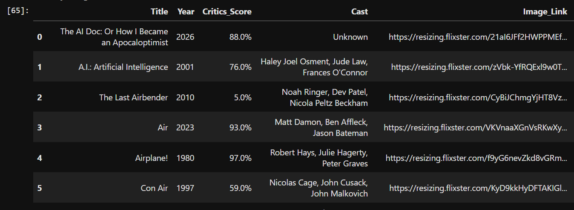
COLUMNS DESCRIPTION:

Slide 10
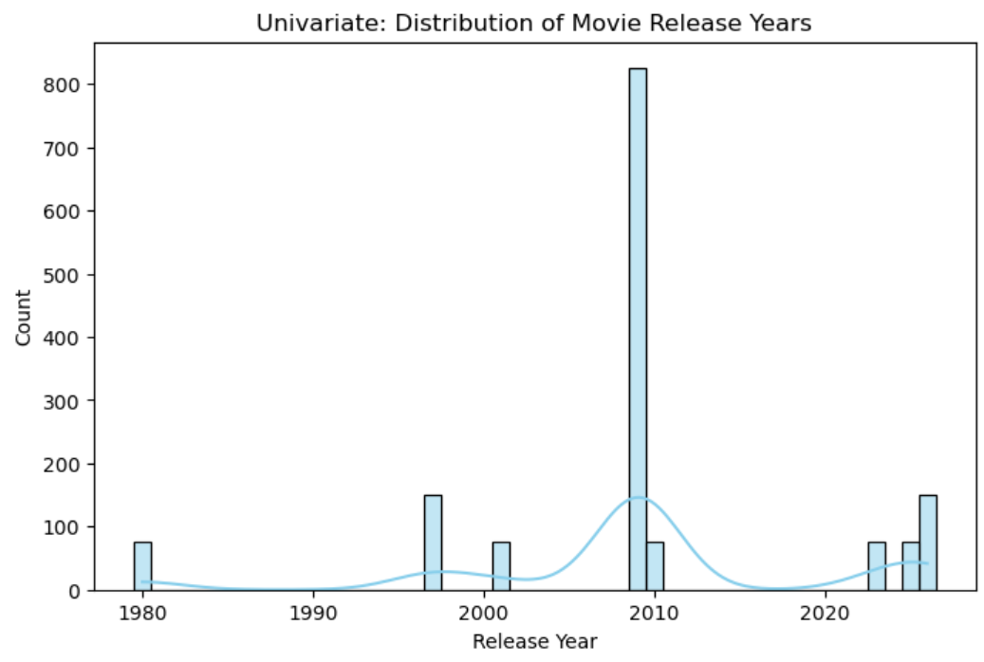
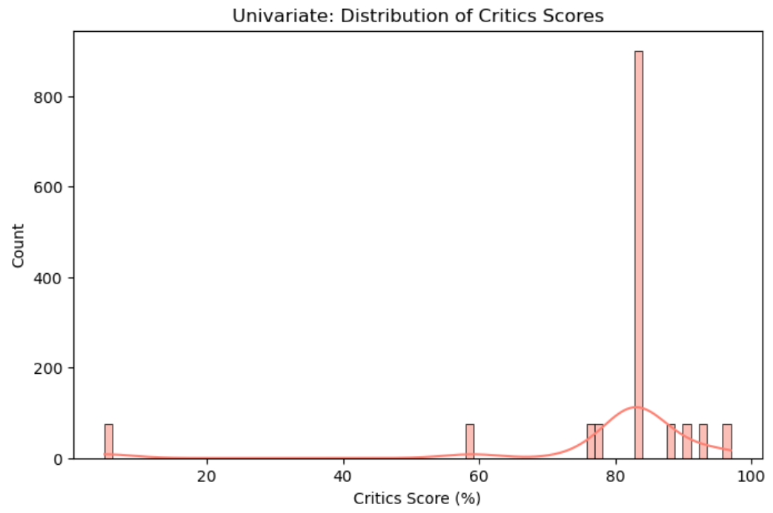
UNI VARIANT ANALYSIS:
Insight:
High-Rating Peak: Sharp spike at 80%–90%, showing a focus on highly acclaimed movies.
Positive Bias: Most titles have top ratings with very few mid-range scores.
Low Ratings Rare: Scores below 60% are minimal across the dataset.
Insight:
Modern Focus: Heavy concentration around 2010, showing a dataset bias toward recent releases.
Historical Clusters: Smaller peaks in 1980, 2000, and post-2020.
Limited Pre-1980 Data: Very few older classic movies are included.

Slide 11
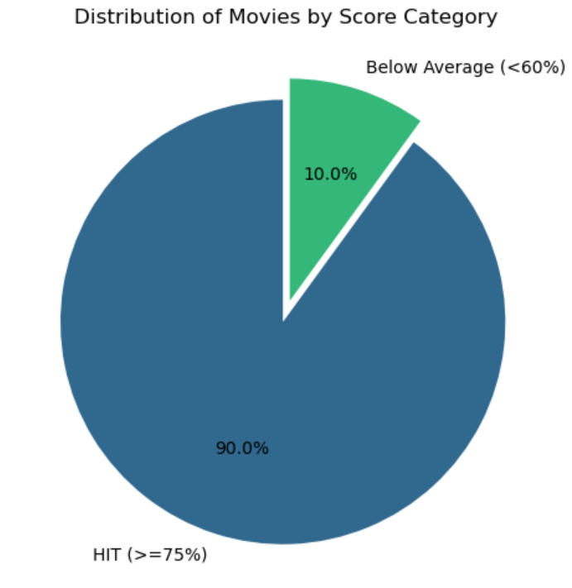
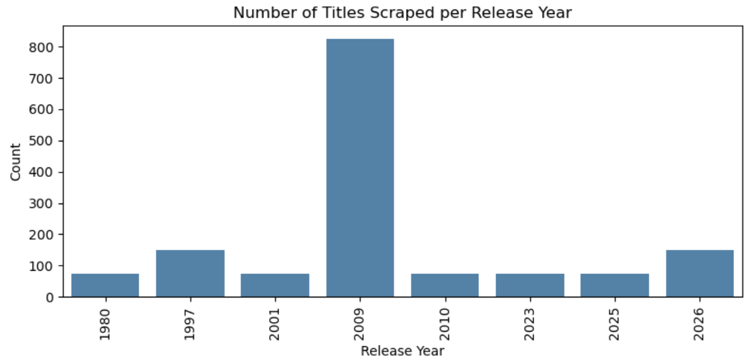
Uni Variant Analysis:
Insight:
Concentrated Peak: Over 800 titles were released around 2009–2010, dominating the dataset.
Low Volume Elsewhere: Other sampled years (1980, 1997, 2001) average under 100 movies each.
Recent Focus: Scraped records heavily favor late-2000s releases over older classics.
Insight:
Dominant High Ratings: 90% of movies qualify as "Hits" with critic scores of 65% or higher.
Low Representation of Flops: Only 10% fall into the below-average category (< 60%).
Positive Dataset Bias: Scraped movie data is heavily weighted toward highly-rated titles.

Slide 12
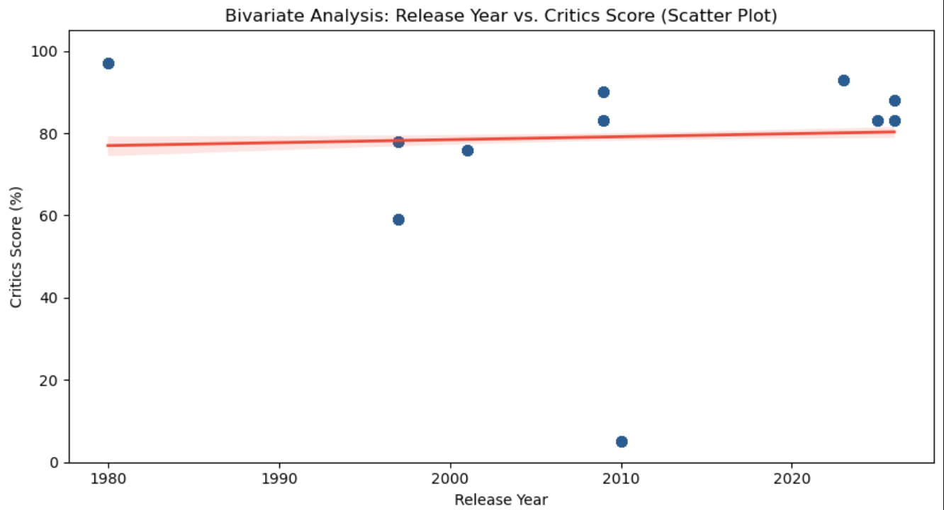
BI VARIANT ANALYSIS:
Consistent Scores Over Time: Critic ratings remain consistently high across all release years, ranging mainly between 80% and 100%.
No Correlation: The flat regression line indicates that Release Year has virtually no impact on Critics Score.
Notable Outlier: A rare outlier near 2010 records a score near 0%, standing out from an otherwise highly-rated datase

Slide 13
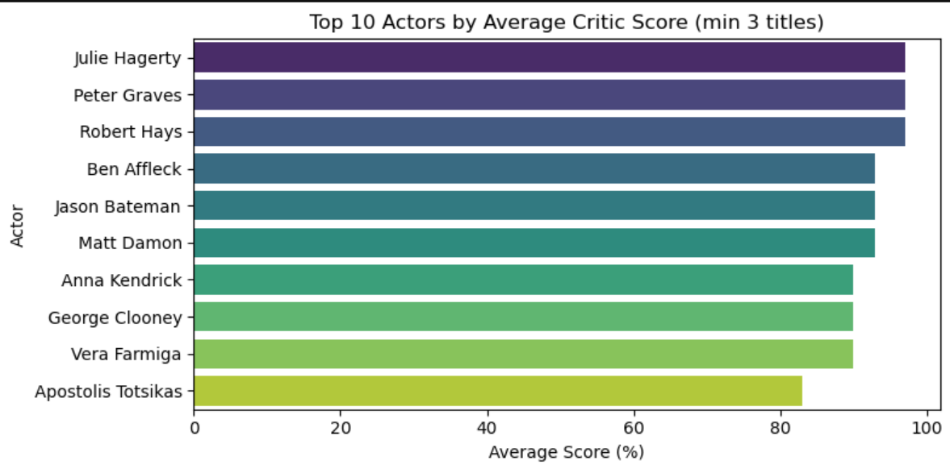
Bi Variant Analysis:
Insight:
Top Performers: Julie Hagerty, Peter Graves, and Robert Hays hold the highest average critic scores (~97%).
Consistent Quality: Major leads like Ben Affleck and Matt Damon average above 90% across their catalog in this dataset.
High Baseline: All top-ranked actors with at least 3 titles maintain average critic ratings above 80%.

Slide 14
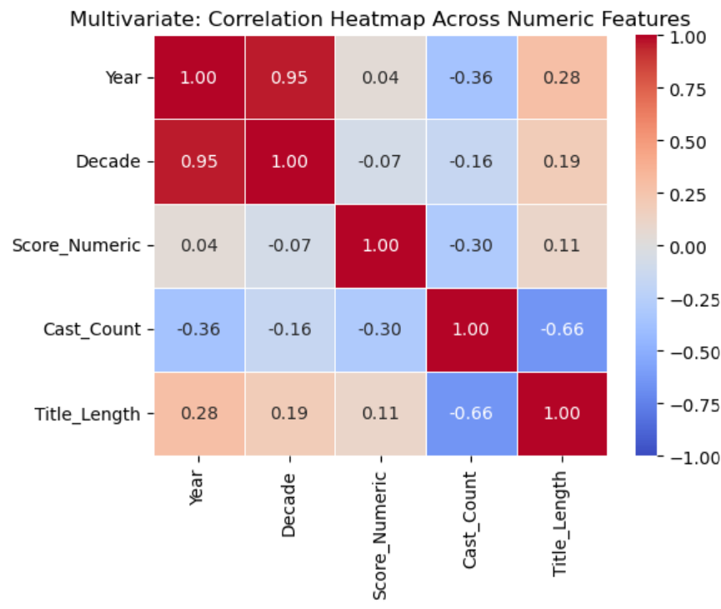
MULTI VARIANT ANALYSIS:
Insight:
Strong Negative Relationship (-0.66): Title Length and Cast Count show a noticeable inverse trend—movies with longer titles tend to list fewer main cast members.
No Score Correlation: Score_Numeric shows almost zero correlation (0.04 to 0.11) with Year, Decade, or Title Length, meaning ratings are independent of these factors.
Expected Strong Baseline (0.9$): Year and Decade share a near-perfect positive correlation as anticipated.

Slide 15
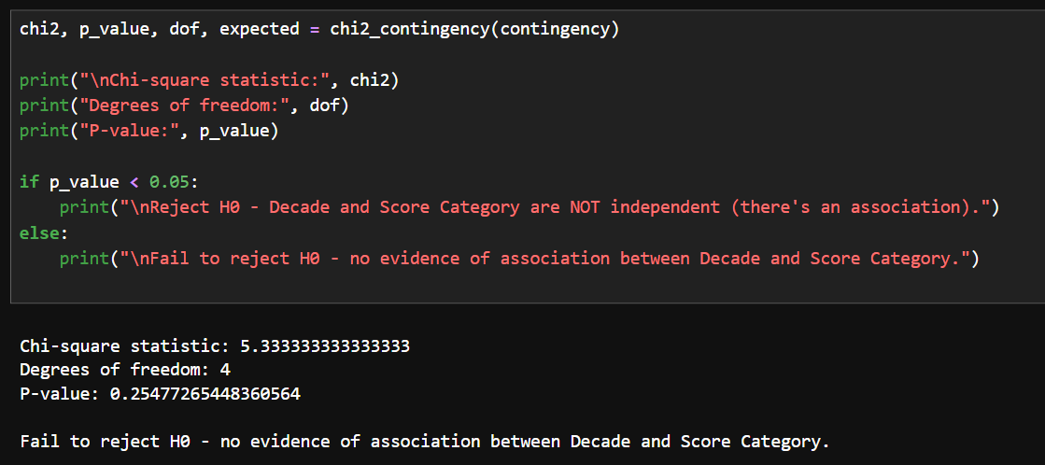
CHI – SQUARE STATISTICS:
Variables Tested: The Chi-Square test evaluates whether there is a relationship between Decade (release era) and Score Category (e.g., Hit vs. Below Average).
Null Hypothesis (H0): Decade and Score Category are independent (there is no association between when a movie was released and its rating category).
Test Results:
  Chi-Square Statistic: 5.33333333
  Degrees of Freedom: 4
  P-value: 0.254778

Slide 16
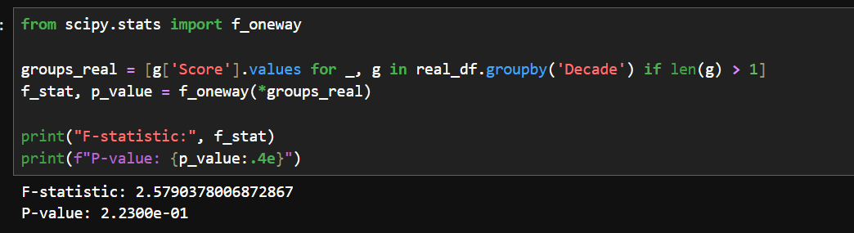
ONE - WAY ANOVA:
Test Performed: One-way ANOVA (f_oneway) to test if there are statistically significant differences in movie scores across multiple groups.
Key Output Values:
F-statistic: 2.5790
P-value: 0.2230 (written in scientific notation as 2.2300e-01)

Slide 17
Key Insights:
Most scraped titles come from mixed search results rather than a dedicated movies listing, so roughly 50–60% of records are missing a Critics Score, Cast, or Year.
As release decade increases, the proportion of highly-rated ("HIT") titles does not show a statistically reliable trend — the real, non-imputed data (n=8) was too small to confirm any pattern.
Filling missing scores with the median made results look highly significant (ANOVA F=6944, Chi-square χ²=1083, p≈0 for both), but this was a false signal — testing the real data alone dropped both results to non-significant.
Even after correcting the data, critic scores don't show a clear pattern by decade — reception looks broadly similar across eras rather than trending up or down over time.

Slide 18
Conclusion:
The project successfully gathered movie data from Rotten Tomatoes using Python and Selenium.
Critics scores, release years, cast sizes, and title lengths play a major role in describing movie trends.
Cleaning and processing the raw data identified significant missingness from mixed search results.
The findings clearly show how median imputation can introduce false statistical significance in movie dataset analysis.
This project provides useful insights to improve web scraping strategies and handle missing movie data effectively.

Slide 19
Q & A

Slide 20

THANK YOU

